Slide 1
Software Security Fundamentals-SAMM-2
Software Assurance Maturity Model (SAMM) developed by OWASP
A guide to building security into software development
96 page PDF
http://www.opensamm.org/downloads/SAMM-1.0.pdf

Slide 2

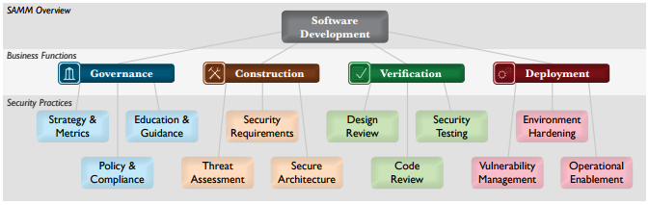
Software Security Fundamentals-SAMM-2

Slide 3
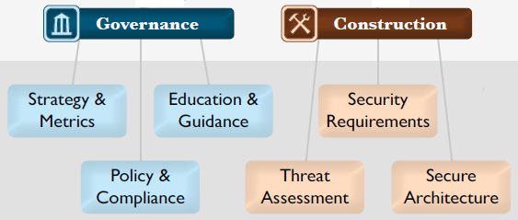
Software Security Fundamentals-SAMM-2

Slide 4
Software Security Fundamentals-SAMM-2
OWASP Software Assurance Maturity Model (SAMM) Construction Phase:
Security Requirements
Threat Assessment
Secure Architecture

Slide 5
Software Security Fundamentals-SAMM-2
Security Requirements:
Focused on proactively specifying the expected behavior of software with respect to security

Slide 6
Software Security Fundamentals-SAMM-2
Security Requirements:
…Through addition of analysis activities at the project level, security requirements are initially gathered based on the high-level business purpose of the software

Slide 7
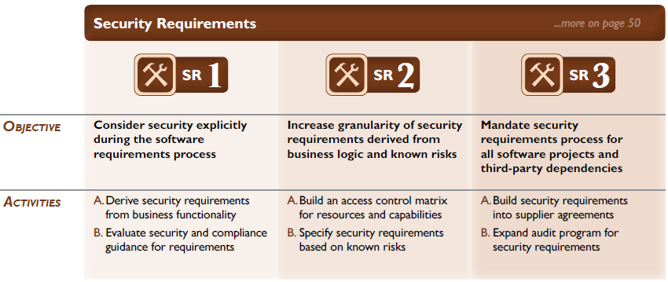
Software Security Fundamentals-SAMM-2

Slide 8
Software Security Fundamentals-SAMM-2
Threat Assessment:
Centered on identification and understanding the project-level risks based on the functionality of the software being developed and characteristics of the runtime environment

Slide 9
Software Security Fundamentals-SAMM-2
Threat Assessment:
…From details about threats and likely attacks against each project, the organization as a whole operates more effectively through better decisions about prioritization of initiatives for security

Slide 10
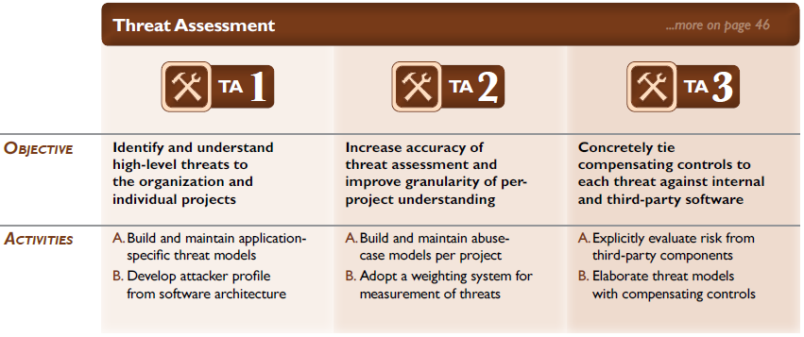
Software Security Fundamentals-SAMM-2

Slide 11
Software Security Fundamentals-SAMM-2
Secure Architecture:
Focused on proactive steps for an organization to design and build secure software by default

Slide 12
Software Security Fundamentals-SAMM-2
Secure Architecture:
By enhancing the software design process with reusable services and components, the overall security risk from software development can be dramatically reduced.

Slide 13
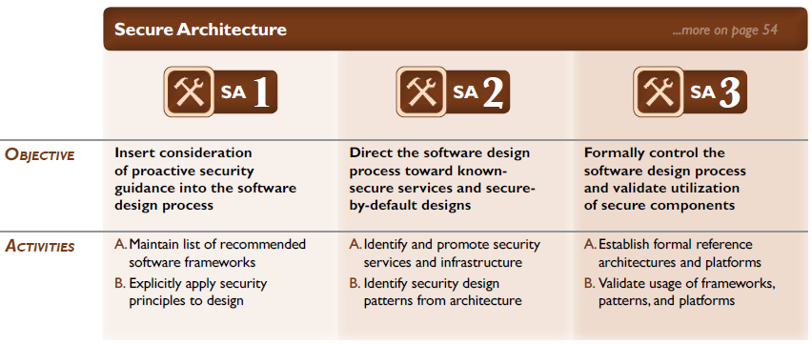
Software Security Fundamentals-SAMM-2

Slide 14
Software Security Fundamentals-SAMM-2
SAMM is an excellent model for software security and we look at the verification and deployment phases as part of testing and validation (future module)…
END

